Slide 1
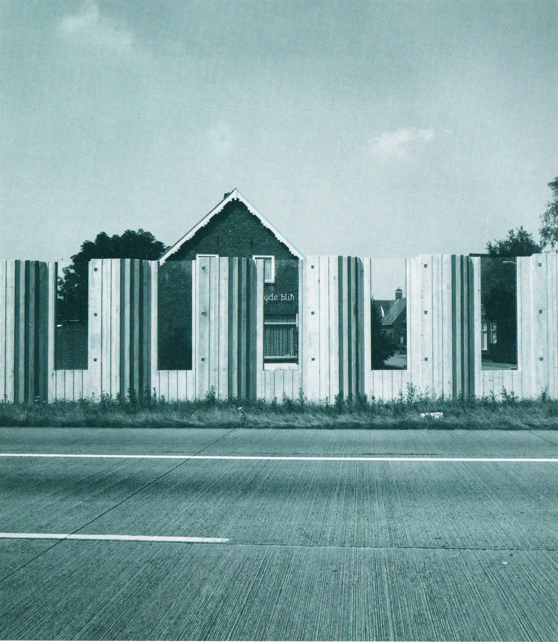
Road noise in the Netherlands
Estimating the willingness-to-pay for noise reduction

Slide 2
Research questions
What are households willing to pay (or paying) for noise reduction?
What are (affected) households willing to pay for a sound barrier wall

Slide 3
Data availability
Dataset | Content | Period
NVM | Housing prices, characteristics | 2000-2013
Nat. Wegenbestand (NWB) | Highway ramps | 2008-2015
Wegenlijst RWS | Roads | 1999-2015
Weggegevens (geluidsbeperkingen) | Sound barrier objects | 2005-2015

Slide 4
State of affairs
Cleaned data, removed outliers
Calculated distances of houses to roads, ramps and soundbarriers.
If soundbarrier distance < 600 meters AND soundbarrier distance < road distance then a house is affected
Statistical tests show funny results:
Soundbarrier effect insignificant ( negative sign)
Accessibility effect positive?

Slide 5
Challenges
Proper model specification
When is a house sale ‘treated’
Alternative accessibility parameter
Maybe ramp distance picks up on different things in urban and peripheral areas
Clearer data on noise barriers
Look for soundbarrier construction instances by hand
Find noise contourzone dataset for plan B

Slide 6
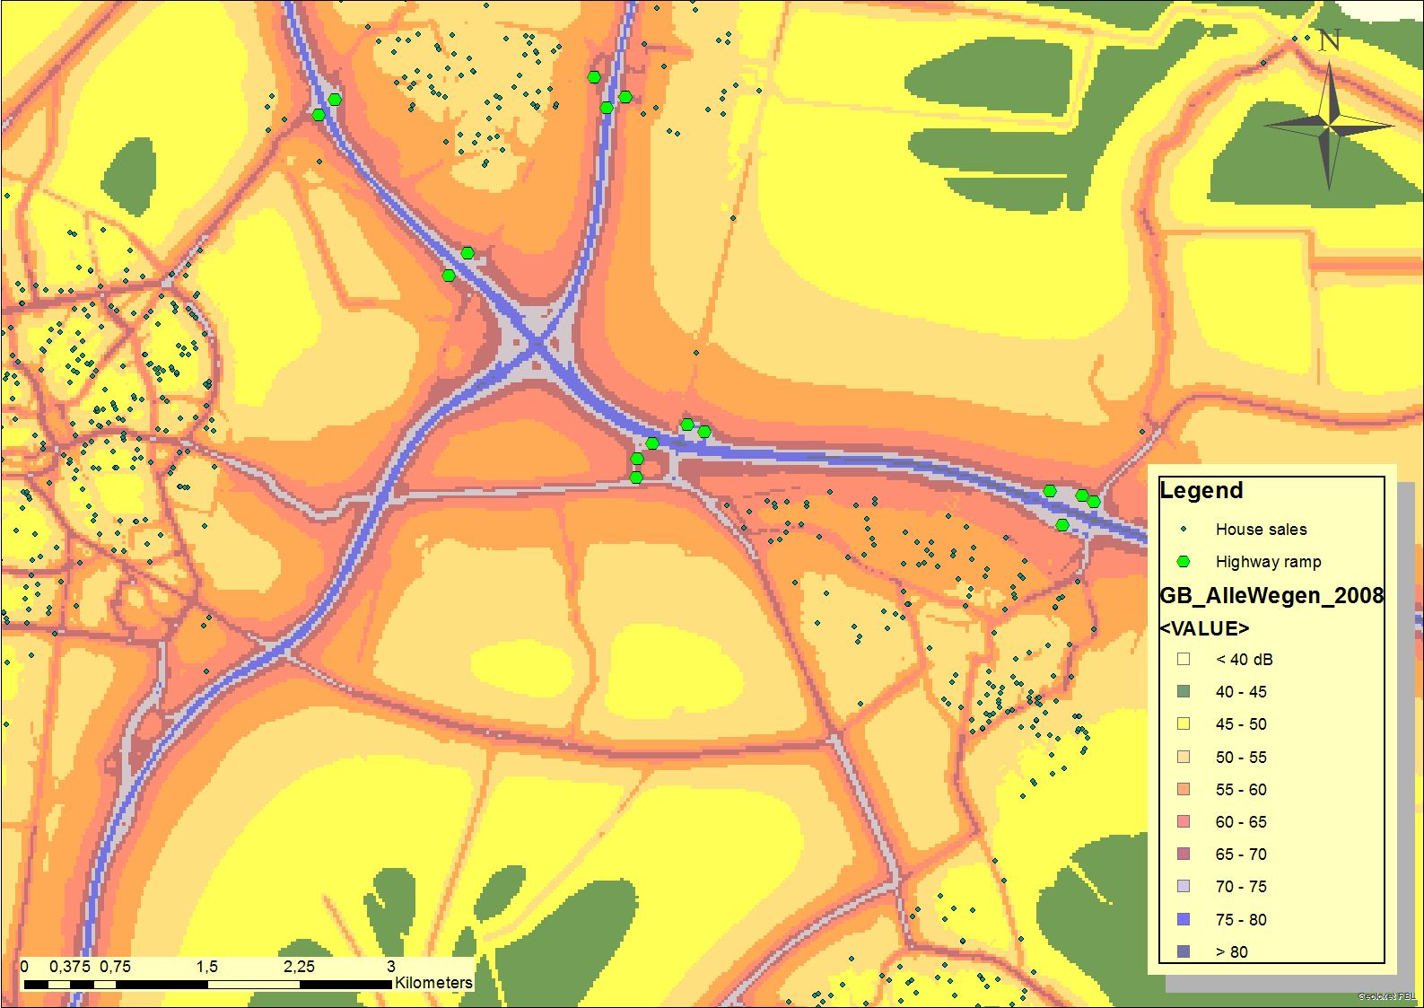
Noise contour zones

